Slide 1
UPPER SIXTH ARTS
GEOGRAPHY
Lesson 1
Natural Resources
Notes:
Good morning, class, and welcome to our geography lesson. I am your geography teacher, Mr Kamdem. Today we are starting Lesson 1: Natural Resources.

Slide 2
CLASS INFO
Class, Chapter and Duration
Class | Upper Sixth Arts
Chapter | Module 6: Understanding and managing the dynamics of economic activities across the world in general and Cameroon in particular
Duration | 2 periods (2 × 50 minutes)
Notes:
This lesson is for Upper Sixth Arts. It belongs to Module 6: Understanding and managing the dynamics of economic activities across the world in general and Cameroon in particular. We shall need 2 periods to cover it.

Slide 3
IDENTIFICATION
Lesson Identification
Topic | Resources and Economic Activities
Sub-topic | Resources and Economic Activities
Lesson | Lesson 1: Natural Resources
Notions / Concepts | Resource, natural resource, renewable, non-renewable, resource use, technology.
Syllabus focus | Meaning; classification into renewable and non-renewable resources; spatial variations in resource use and its factors (culture, population size, technology).
Competence | Learners are able to classify natural resources and explain why their use varies from place to place.
Notes:
Our topic is Resources and Economic Activities, and the sub-topic is Resources and Economic Activities. The key notions we shall use today are: resource, natural resource, renewable, non-renewable, resource use, technology. At the end, you should be able to do this: learners are able to classify natural resources and explain why their use varies from place to place.

Slide 4

HOMEWORK CORRECTION
Correction of the Homework
Question (Lesson 22: Controlling Town Spread):
List three natural resources found in Cameroon.
Notes:
Before we start the new lesson, let us correct the homework I gave you at the end of Lesson 22: Controlling Town Spread. The question was: List three natural resources found in Cameroon. Take out your exercise books.

Slide 5
HOMEWORK CORRECTION
Correction: Possible Answer
Examples: forests, oil, gas, bauxite, iron ore, rivers, fertile soils (any three).
Notes:
Here is a good answer. Examples: forests, oil, gas, bauxite, iron ore, rivers, fertile soils (any three). Compare it with your own answer and correct your work in red.

Slide 6
LESSON PLAN
Lesson Plan
Correction of the homework
Objectives and recall
Real-life situation and action to take
Learning activities
Board summary
Evaluation, remediation and homework
Notes:
Here is the plan of our lesson today. First, we shall correct the homework. Then we shall look at the objectives and recall what you already know. After that, we shall study a situation from real life and the action to take, and do the learning activities. Finally, we shall copy the board summary, do the evaluation and the remediation, and I will give you the homework.

Slide 7
OBJECTIVES
Objectives
By the end of this lesson, you should be able to:
Define a natural resource.
Classify resources into renewable and non-renewable.
Explain the factors of resource use.
Notes:
By the end of this lesson, you should be able to do three things. Number 1: define a natural resource. Number 2: classify resources into renewable and non-renewable. Number 3: explain the factors of resource use.

Slide 8
PREVIOUS KNOWLEDGE
Previous Knowledge
People depend on land, water and forests.
Minerals and oil are found underground.
Notes:
Let us first remember what you already know. People depend on land, water and forests. Minerals and oil are found underground. Keep this in mind, because we shall build on it today.

Slide 9
REAL-LIFE SITUATION
Situation in Real Life
Cameroon has large forests, rivers, oil, bauxite and fertile soils, yet many of these resources are little used. Japan has few natural resources but is one of the richest countries in the world.
Notes:
Listen carefully to this situation from real life. Cameroon has large forests, rivers, oil, bauxite and fertile soils, yet many of these resources are little used. Japan has few natural resources but is one of the richest countries in the world. Think about it, because I am going to ask you some questions.

Slide 10
REAL-LIFE SITUATION
Situation: Question 1
What is the problem in the situation?
Notes:
Question 1: What is the problem in the situation? Think for a moment, then raise your hand to answer.

Slide 11
REAL-LIFE SITUATION
Answer
Having resources does not always mean using them.
Notes:
Good. Having resources does not always mean using them.

Slide 12
REAL-LIFE SITUATION
Situation: Question 2
Why does Japan use resources well?
Notes:
Question 2: Why does Japan use resources well? Think for a moment, then raise your hand to answer.

Slide 13
REAL-LIFE SITUATION
Answer
It has high technology, skills and capital.
Notes:
Good. It has high technology, skills and capital.

Slide 14
REAL-LIFE SITUATION
Situation: Question 3
Which resources of Cameroon are non-renewable?
Notes:
Question 3: Which resources of Cameroon are non-renewable? Think for a moment, then raise your hand to answer.

Slide 15
REAL-LIFE SITUATION
Possible Answer
Oil, bauxite, iron ore, gold.
Notes:
Good. Oil, bauxite, iron ore, gold.

Slide 16
ACTION TO TAKE
Action to Take
Use natural resources sustainably so that future generations can also benefit.
Notes:
From this situation, the action we are working towards in this lesson is the following: use natural resources sustainably so that future generations can also benefit.

Slide 17
JUSTIFICATION
Justification of the Lesson
This lesson introduces economic geography: how people use the resources of the Earth.
Notes:
Why is this lesson important for you? This lesson introduces economic geography: how people use the resources of the Earth.

Slide 18

1. MEANING
Activity 1
The forest, a natural resource.
Notes:
Activity 1. Look carefully at this picture: the forest, a natural resource. Observe every detail before I ask the question.

Slide 19
1. MEANING
Activity 1: Question
What is a natural resource?
Notes:
Here is the question for Activity 1: What is a natural resource? Take one minute to think and write your answer in your rough notebook.

Slide 20
1. MEANING
Activity 1: Answer
Anything from nature that people can use, such as land, water, forests or minerals.
Notes:
Let us check the answer together. Anything from nature that people can use, such as land, water, forests or minerals.

Slide 21
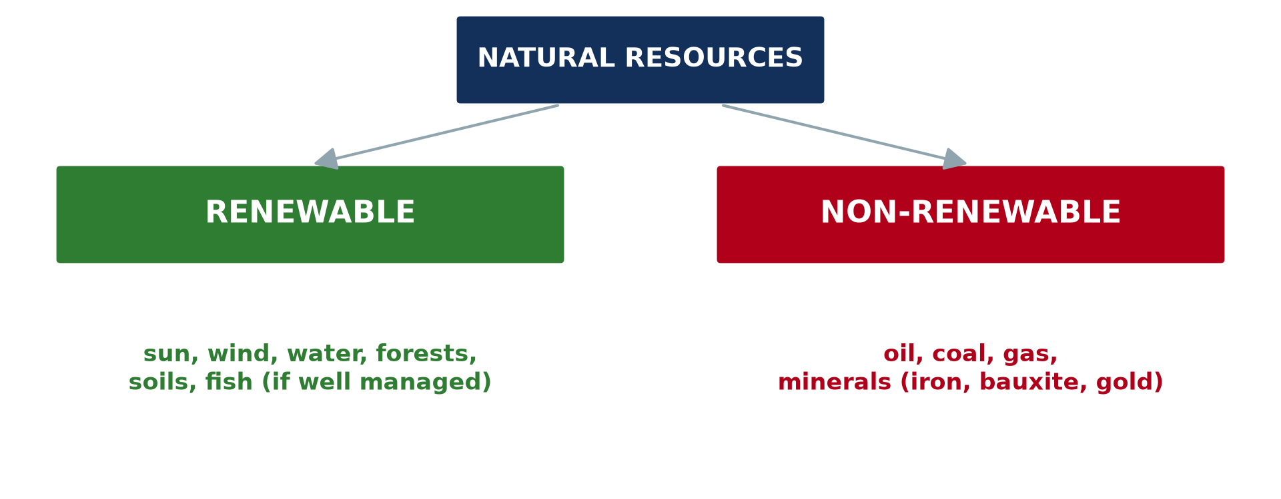
2. CLASSIFICATION
Activity 2
Renewable and non-renewable resources.
Notes:
Activity 2. Look carefully at this diagram: renewable and non-renewable resources. Observe every detail before I ask the question.

Slide 22
2. CLASSIFICATION
Activity 2: Question
Distinguish renewable and non-renewable resources.
Notes:
Here is the question for Activity 2: Distinguish renewable and non-renewable resources. Take one minute to think and write your answer in your rough notebook.

Slide 23
2. CLASSIFICATION
Activity 2: Answer
Renewable resources can be replaced naturally; non-renewable resources are used up.
Notes:
Let us check the answer together. Renewable resources can be replaced naturally; non-renewable resources are used up.

Slide 24
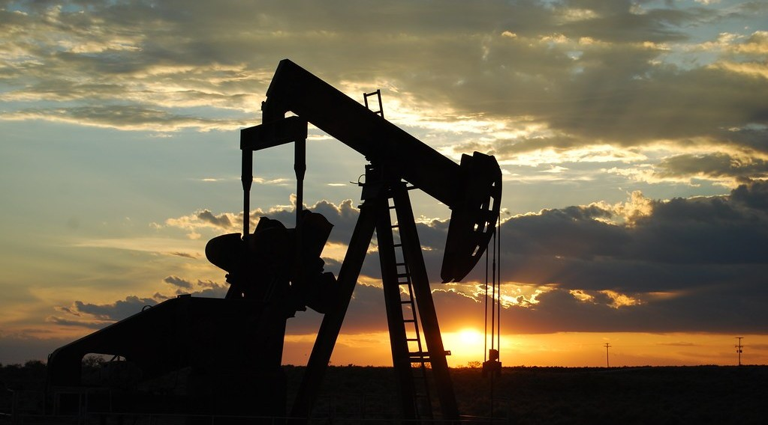
2. CLASSIFICATION
Activity 3
An oil pump.
Notes:
Activity 3. Look carefully at this picture: an oil pump. Observe every detail before I ask the question.

Slide 25
2. CLASSIFICATION
Activity 3: Question
Why is oil called non-renewable?
Notes:
Here is the question for Activity 3: Why is oil called non-renewable? Take one minute to think and write your answer in your rough notebook.

Slide 26
2. CLASSIFICATION
Activity 3: Answer
It took millions of years to form and cannot be replaced once used.
Notes:
Let us check the answer together. It took millions of years to form and cannot be replaced once used.

Slide 27
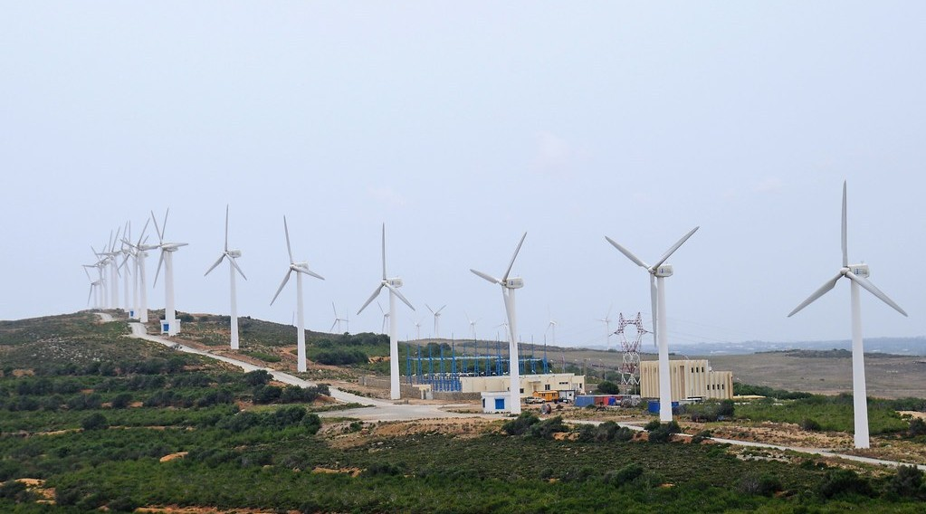
3. FACTORS OF RESOURCE USE
Activity 4
Wind turbines.
Notes:
Activity 4. Look carefully at this picture: wind turbines. Observe every detail before I ask the question.

Slide 28
3. FACTORS OF RESOURCE USE
Activity 4: Question
How does technology change what is a resource?
Notes:
Here is the question for Activity 4: How does technology change what is a resource? Take one minute to think and write your answer in your rough notebook.

Slide 29
3. FACTORS OF RESOURCE USE
Activity 4: Answer
New technology lets people use things that were useless before, like wind.
Notes:
Let us check the answer together. New technology lets people use things that were useless before, like wind.

Slide 30

3. FACTORS OF RESOURCE USE
Activity 5
A crowded market.
Notes:
Activity 5. Look carefully at this picture: a crowded market. Observe every detail before I ask the question.

Slide 31
3. FACTORS OF RESOURCE USE
Activity 5: Question
Give two other factors of resource use.
Notes:
Here is the question for Activity 5: Give two other factors of resource use. Take one minute to think and write your answer in your rough notebook.

Slide 32
3. FACTORS OF RESOURCE USE
Activity 5: Answer
Population size and culture (also capital and government policy).
Notes:
Let us check the answer together. Population size and culture (also capital and government policy).

Slide 33
BOARD SUMMARY
Board Summary
Topic: Resources and Economic Activities
Sub-topic: Resources and Economic Activities
Lesson 1: Natural Resources
Notes:
Now we are going to copy the board summary. Write the title and the headings neatly in your notebooks. I will give you enough time for each slide, so do not rush.

Slide 34
BOARD SUMMARY
1. Meaning of Natural Resources
Natural resources can be understood as follows:
Natural resource: It is anything found in nature that people can use to satisfy their needs, such as land, water, forests, minerals and energy.
Notes:
Let us copy Meaning of Natural Resources. Natural resources can be understood as follows. On this slide we have Natural resource. Write each point on a new line, with the key term first, and explain it in your own words when we revise. When you finish, we go to the next slide.

Slide 35
BOARD SUMMARY
1. Meaning of Natural Resources (continued)
Resource and technology: Something becomes a resource only when people have the knowledge and technology to use it. Wind and sunlight became resources with turbines and solar panels.
Notes:
We continue with Meaning of Natural Resources. On this slide we have Resource and technology. Write each point on a new line, with the key term first, and explain it in your own words when we revise.

Slide 36
BOARD SUMMARY
2. Classification of Resources
Natural resources are classified into two types:
Renewable resources: They are renewed naturally and can last for ever if well managed, such as sunlight, wind, water, forests, soils and fish. Over-use can destroy forests, soils and fish stocks.
Notes:
Let us copy Classification of Resources. Natural resources are classified into two types. On this slide we have Renewable resources. Write each point on a new line, with the key term first, and explain it in your own words when we revise. When you finish, we go to the next slide.

Slide 37
BOARD SUMMARY
2. Classification of Resources (continued)
Non-renewable resources: They exist in fixed amounts and take millions of years to form, such as oil, coal, gas and minerals. Once used, they cannot be replaced.
Notes:
We continue with Classification of Resources. On this slide we have Non-renewable resources. Write each point on a new line, with the key term first, and explain it in your own words when we revise.

Slide 38
BOARD SUMMARY
2. Classification of Resources
Illustration: renewable and non-renewable resources
Notes:
Now draw this illustration in your notebook: renewable and non-renewable resources. Give it a title and label it clearly.

Slide 39
BOARD SUMMARY
3. Spatial Variations and Factors of Resource Use
Resource use varies from place to place because of:
Level of technology: Rich countries have the technology to exploit deep oil, minerals and renewable energy. Poor countries often export raw resources without processing them.
Notes:
Let us copy Spatial Variations and Factors of Resource Use. Resource use varies from place to place because of. On this slide we have Level of technology. Write each point on a new line, with the key term first, and explain it in your own words when we revise. When you finish, we go to the next slide.

Slide 40
BOARD SUMMARY
3. Spatial Variations and Factors of Resource Use (continued)
Population size and wealth: Large and rich populations consume more resources; the USA uses far more energy per person than Cameroon. Growing populations increase pressure on land and water.
Notes:
We continue with Spatial Variations and Factors of Resource Use. On this slide we have Population size and wealth. Write each point on a new line, with the key term first, and explain it in your own words when we revise. When you finish, we go to the next slide.

Slide 41
BOARD SUMMARY
3. Spatial Variations and Factors of Resource Use (continued)
Culture: Beliefs and customs influence what is used, for example sacred forests are protected and some foods are forbidden. Traditional knowledge also guides the use of plants.
Notes:
We continue with Spatial Variations and Factors of Resource Use. On this slide we have Culture. Write each point on a new line, with the key term first, and explain it in your own words when we revise.

Slide 42
FORMATIVE EVALUATION
Evaluation 1
Distinguish renewable and non-renewable resources with examples.
Notes:
Now let us check what you have understood. Question 1: Distinguish renewable and non-renewable resources with examples. Answer in your exercise book.

Slide 43
FORMATIVE EVALUATION
Expected Answer
Renewable: replaced naturally (forests, water). Non-renewable: used up (oil, bauxite).
Notes:
The expected answer is: renewable: replaced naturally (forests, water). Non-renewable: used up (oil, bauxite). If you got it right, well done.

Slide 44
FORMATIVE EVALUATION
Evaluation 2
Give two factors of resource use.
Notes:
Now let us check what you have understood. Question 2: Give two factors of resource use. Answer in your exercise book.

Slide 45
FORMATIVE EVALUATION
Expected Answer
Technology and population size (also culture, capital).
Notes:
The expected answer is: technology and population size (also culture, capital). If you got it right, well done.

Slide 46
REMEDIATION
Remediation
Fill in the blanks:
Resources that can be replaced are ______.
Oil is a ______ resource.
New ______ makes new things become resources.
Notes:
For those who need more practice, fill in the blanks in your exercise book. The answers are: number 1, renewable; number 2, non-renewable; number 3, technology.

Slide 47
HOMEWORK
Homework
List five resources of your region and say whether each is renewable or not.
Notes:
For your homework: List five resources of your region and say whether each is renewable or not. We shall correct it at the beginning of our next lesson.

Slide 48
NEXT LESSON
Next Lesson
Our next lesson will be on:
Lesson 2: What is Agriculture?
Notes:
Our next lesson will be on Lesson 2: What is Agriculture?. Thank you for your attention, and see you next time.

Slide 49
BILINGUAL GAME
Bilingual Game (Jeu Bilingue)
English | Français
Resource | La ressource
Renewable | Renouvelable
Non-renewable | Non renouvelable
Technology | La technologie
Capital | Le capital
Use | L'exploitation
Notes:
Let us play the bilingual game. I say a word in English, and you give me the French word. Then we do the reverse.

Slide 50
LOGBOOK
Official Logbook (1/2)
Module / Topic | Resources and Economic Activities
Lesson Title | Lesson 1: Natural Resources
Expected Learning Outcomes | Define a natural resource. Classify resources into renewable and non-renewable. Explain the factors of resource use.
Competence | Learners are able to classify natural resources and explain why their use varies from place to place.
Notes:
I record this information in the official logbook of the class after the lesson.

Slide 51
LOGBOOK
Official Logbook (2/2)
Matter Taught | Meaning of Natural Resources; Classification of Resources; Spatial Variations and Factors of Resource Use.
Evaluation | Formative evaluation and remediation exercise.
Homework | List five resources of your region and say whether each is renewable or not.
Enrolment / Present / Absent | ____ / ____ / ____
Achievement | To be completed after the lesson.
Notes:
I complete the second page of the logbook: the matter taught, the evaluation, the homework and the attendance.

Slide 52
TEACHER'S NOTE
Teacher's Note
Timing: Homework correction, plan, objectives 8 min | Recall, situation, action 10 min | 5 activities 30 min | Board summary (copying) 30 min | Evaluation, remediation 10 min | Homework, next lesson 5 min | Logbook 7 min
Without the projector (Activity 1): list resources of your region.
Without the projector (Activity 2): sort resources into two lists.
Without the projector (Activity 3): mention oil fields of Cameroon.
Without the projector (Activity 4): discuss solar panels.
Without the projector (Activity 5): list factors.
Notes:
This slide is for me, the teacher: it gives the timing of the lesson and what to do if the projector is not available.

Slide 53
REFERENCES
References
National Geography Syllabus, MINESEC/IGE/IP-SS, 2019 — Module 6 (Economic Geography).
Photo, Activity 1: “Amazon 11” by CIAT International Center for Tropical Agriculture, CC BY-SA 2.0, via Flickr (https://www.flickr.com/photos/38476503@N08/5641587148)
Photo, Activity 3: “Oil Pump Jack” by Paul Lowry, CC BY 2.0, via Flickr (https://www.flickr.com/photos/10039026@N03/2770193028)
Photo, Activity 4: “Wind turbine farm” by World Bank Photo Collection, CC BY-NC-ND 2.0, via Flickr (https://www.flickr.com/photos/10816734@N03/4941489845)
Photo, Activity 5: “Wax market” by zouzouwizman, CC BY 2.0, via Flickr (https://www.flickr.com/photos/61111202@N00/12129001)
Diagrams and animations: drawn for this lesson (Geography Department).
Notes:
These are the references and picture credits used to prepare this lesson.

